Slide 1
Project 2 Attrition and Salary Analysis
Alex Salamah

Slide 2
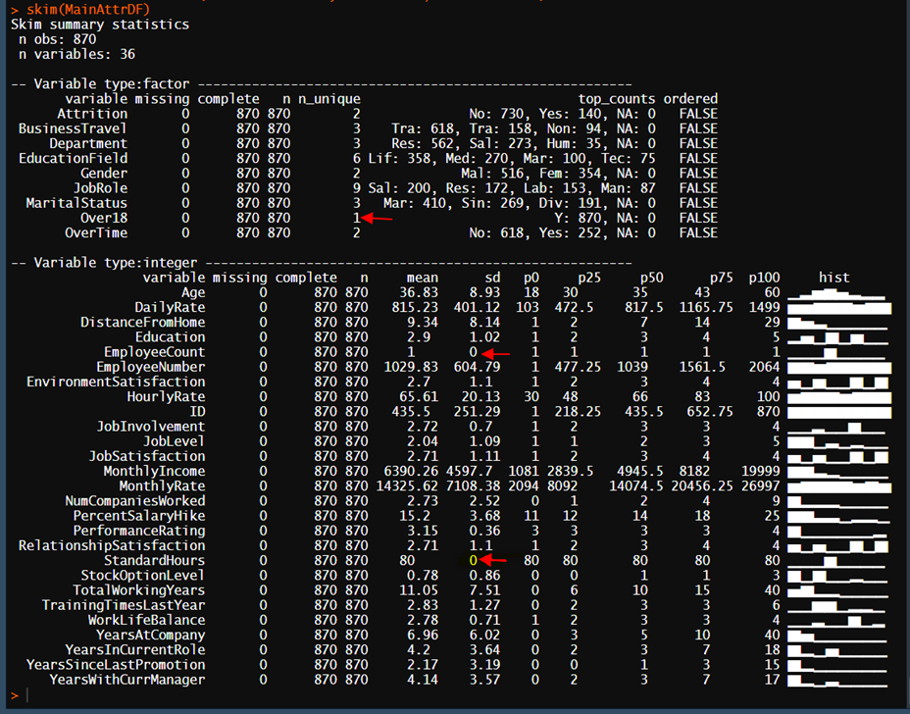
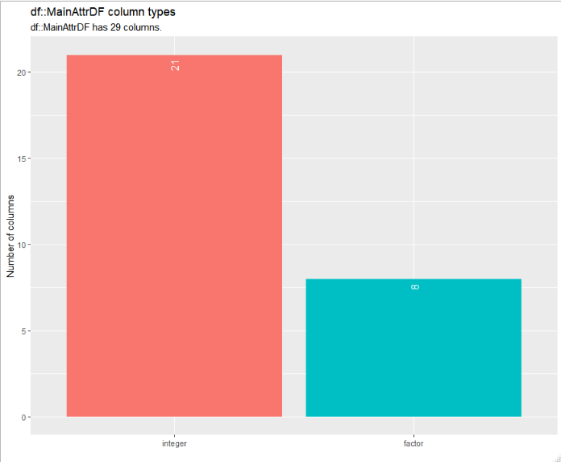
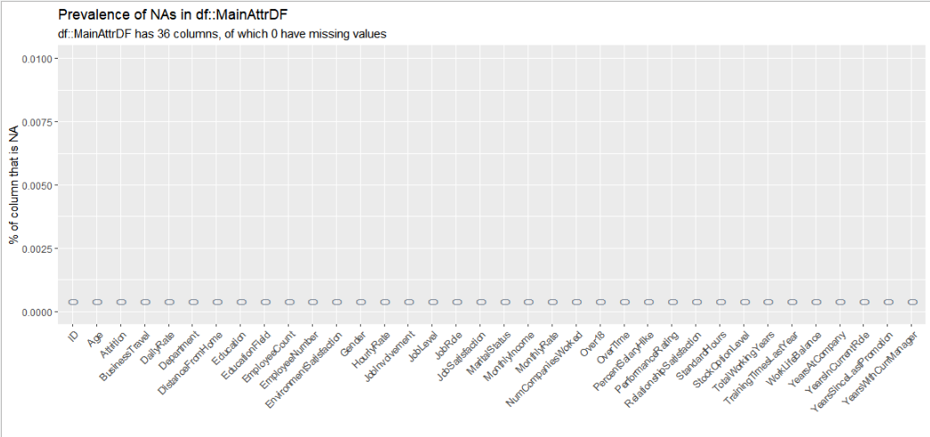
Examining the Attrition dataset, we note that it consists of 870 observations and 36 attributes/variables. The original variables consisted of 27 integers and 9 factors. The skim function output shown (Figure 1) indicates that the “over 18 category has one level and thus it will be removed. Also, since Employee count and standard hours both only have one values (SD = 0) they will also be removed because they are not useful for classification or regression. Finally, Variables that provide similar information such as Hourly, daily, Monthly rate will be removed and we will use Monthly Income instead.
After this variable pruning, we end up with 21 integers and 9 factors (Figure 2). None of the attributes have any missing values as illustrated in (Figure 3).
(Figure 3) Missing Data analysis
(Figure 1) Superfluous variables identified
(Figure 2) Superfluous variables removed
Data Set composition
Notes:
Initial data profiling reveals that the attrition data has 870 observation and 36 variables of which 27 are integers and 9 are factors and none have any missing data. By Examining the, data we notice that we can remove the over 18 variable since it has one category also we can remove the variables that have a standard deviation of 0 as shown in figure 1 these variables are not useful for analysis.
F
inally we can also remove variables that provide the same information. Like hourly / monthly and day rates. After initial pruning the data set we end up with 21 integers and 9 factors.

Slide 3
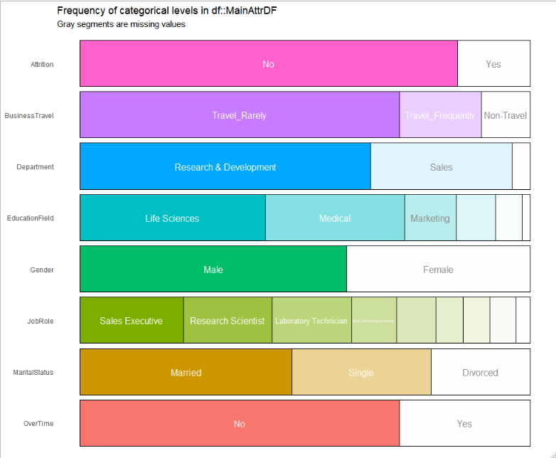
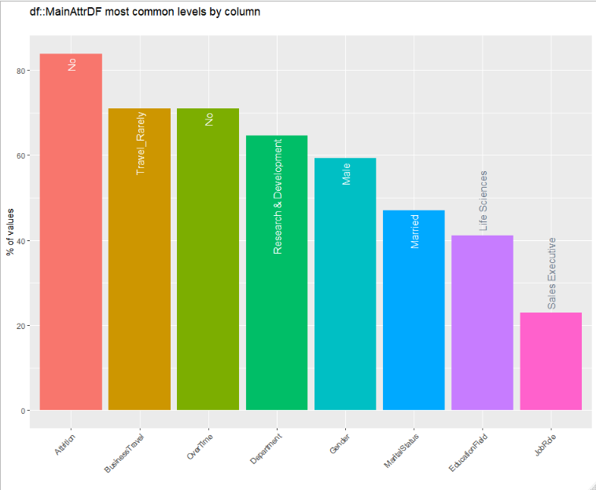
Categorical Analysis reveals the existence of categorical imbalance especially in the attrition category where approximately 85% of the values are “No”. Since this is the response factor, over and/or under sampling techniques may have to be applied during modeling to produce better results. Additional imbalances exist in Business Travel, overtime and department. The Gender is slightly imbalanced with 59% of the values are males.
Figure 1: Categorical analysis – Frequency diagram
Figure 2: Categorical analysis – Imbalance diagram

Slide 4
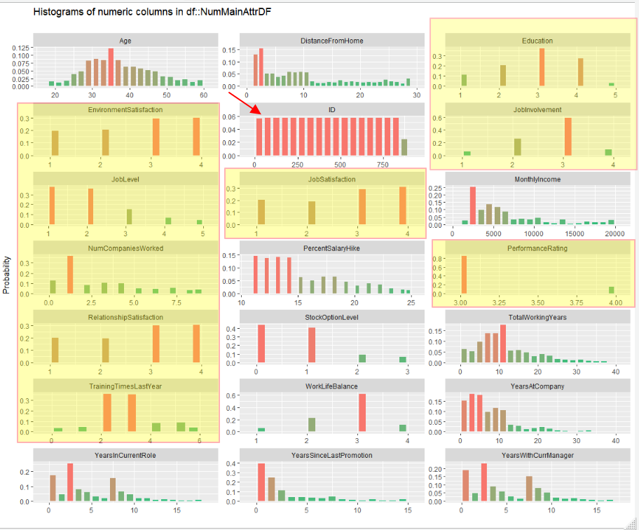
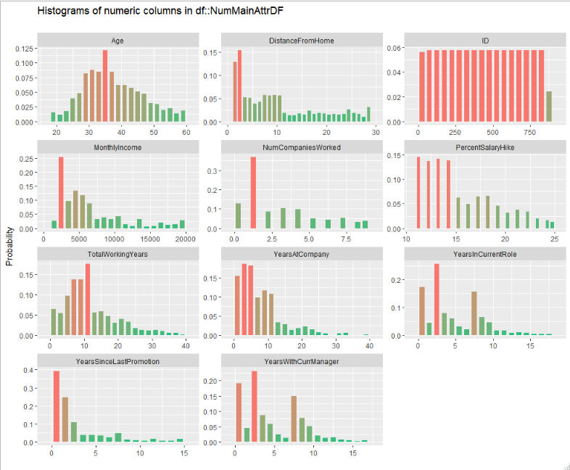
Examining the numerical variables, reveals discrete variables that may need to be converted to factors or categorical variables. These are highlighted in yellow Figure 1. We also noticed the Age attribute shows a normal distribution while the “distance from home”, “monthly income”, “Total Working years”, “years at company”, “years in current role”, “years since last promotions” all appear to be slightly skewed distributions. These distribution may benefit from a log transformation
Figure 1: Numerical Variables Analysis – discrete variable identified
Figure 2: Numerical Variables Analysis – discrete variables removed

Slide 5
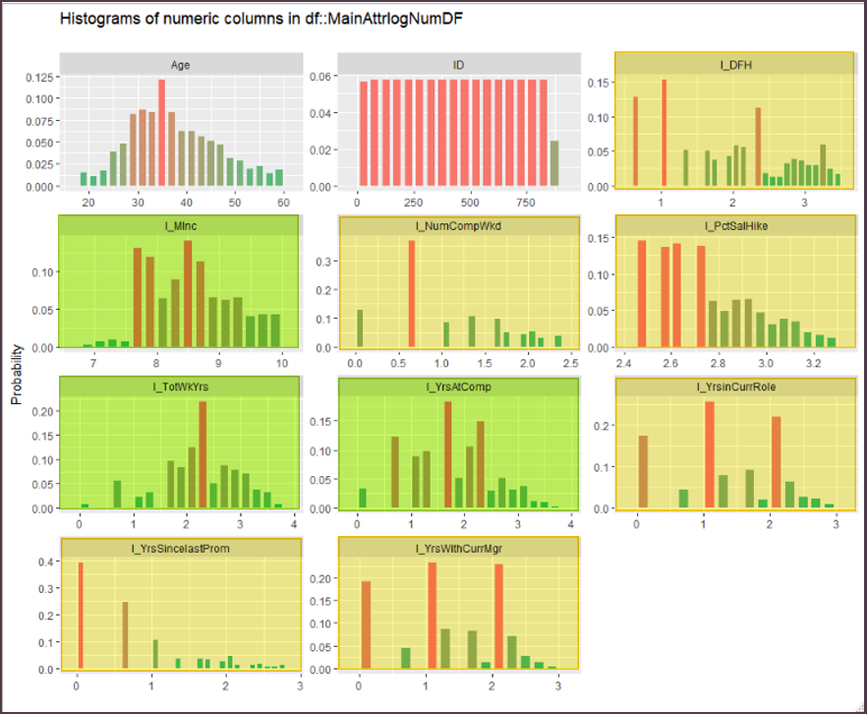
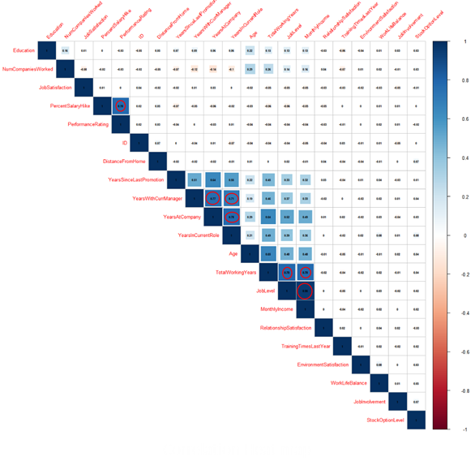
Applying log transformation on skewed distributions seems to have helped Monthly Income , Total Work years, and Years at company be normally distributed (Green highlighted charts below.) However, it did not have much effect on distance from home, Number of company worked, Percent Salary Hike, year in current role, years since last promotion, Years with cur Manager (yellow highlighted charts below.)
Heatmap shows significant correlation between the following variables. This requires analysis to decide which attributes to exclude from the model to avoid overfitting.
Figure 1: Log Transformation to improve distribution

Slide 6
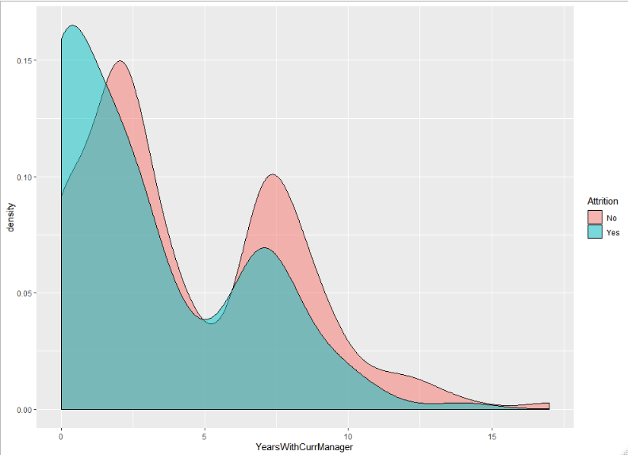
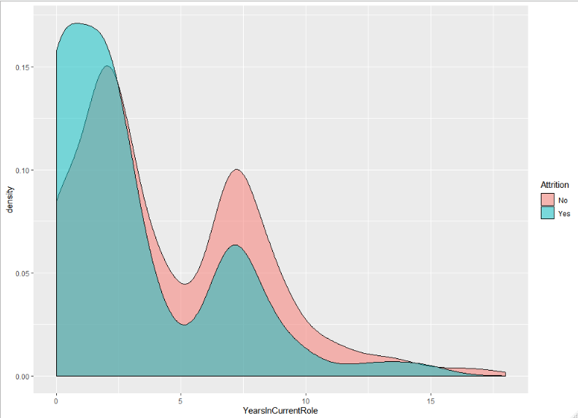
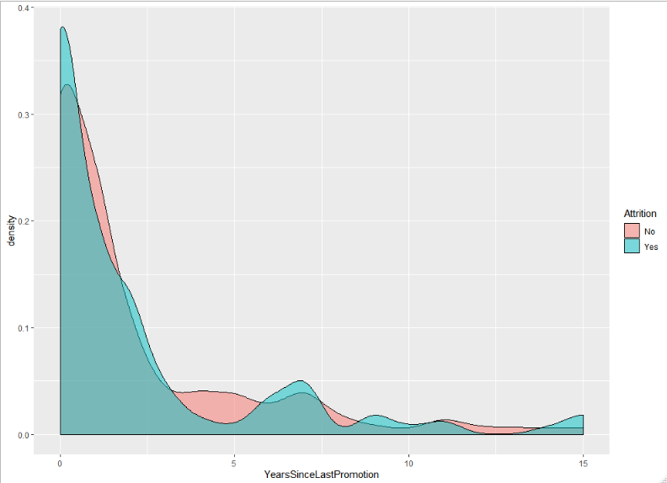
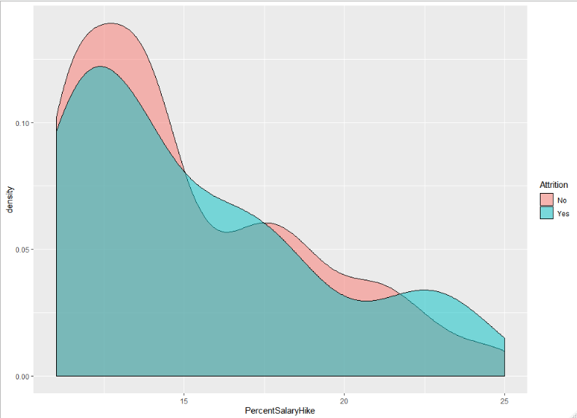
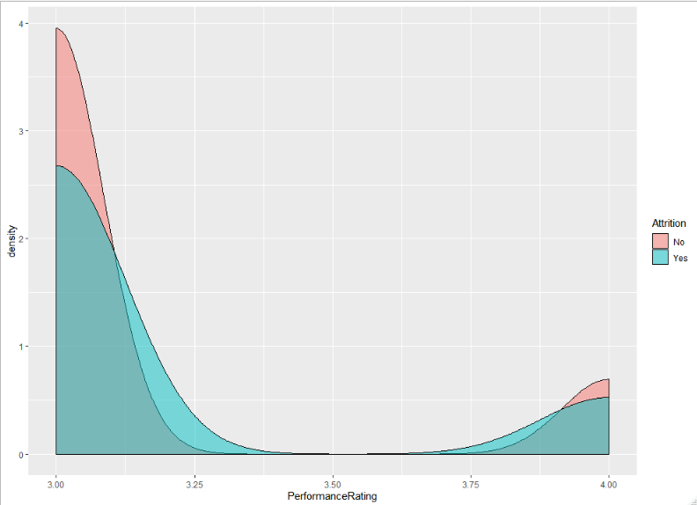
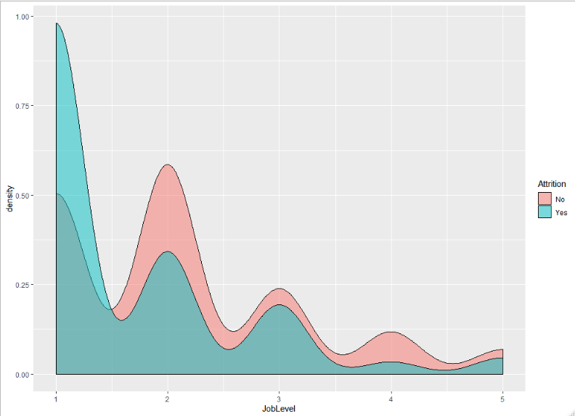
Density plots for: Percent Salary Hike, Performance Rate , Years In Current Role, Years with current manager, Job level, and years since last promotion show that these variables do not have a significant effect on attrition. Job level 2, employees who have been in their current role for seven years and those who have been with the same manger for around seven years show some differences in attrition rate
Years with Current Manager
Years In Current Role
Years Since Last Promotion
Percent Salary Hike
Performance Rating
Job Level

Slide 7
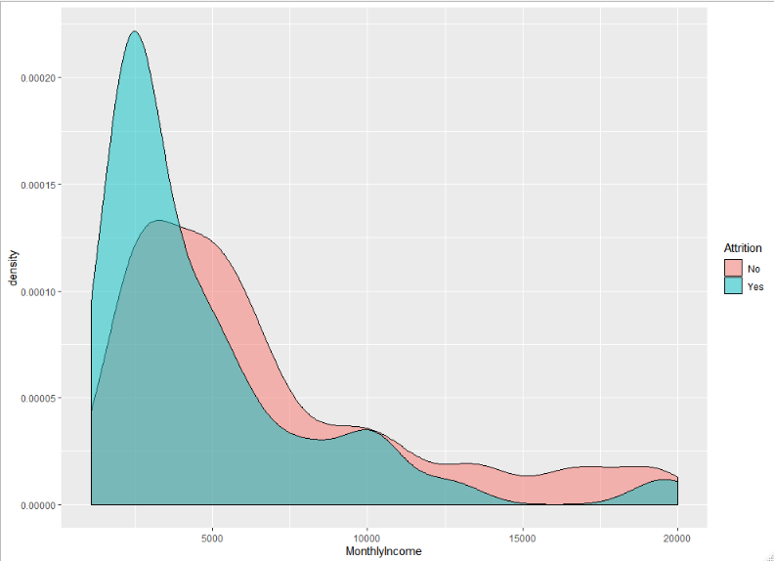
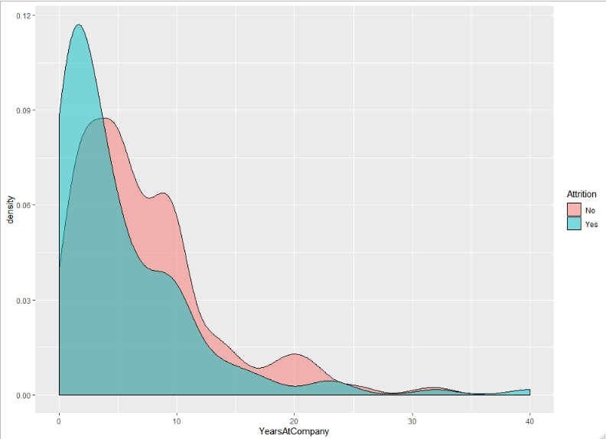
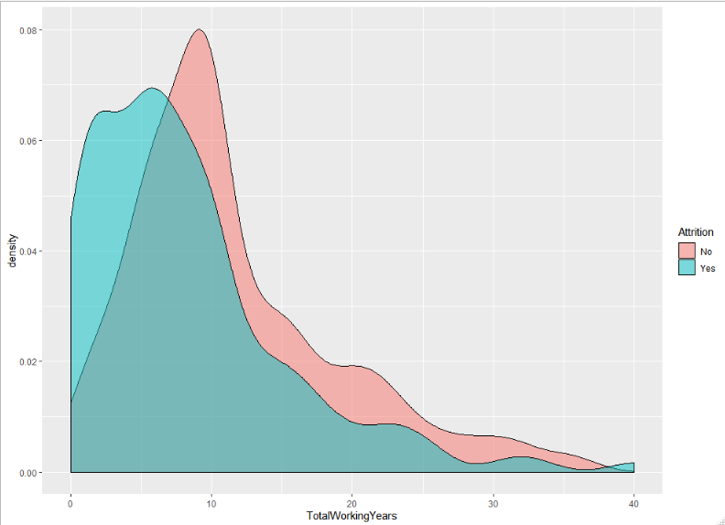
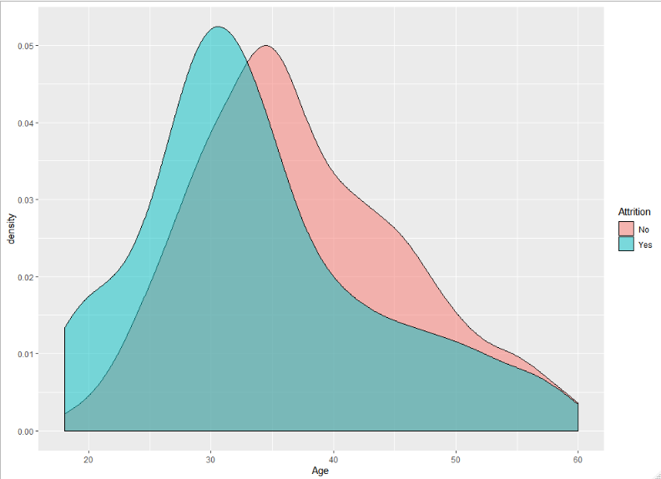
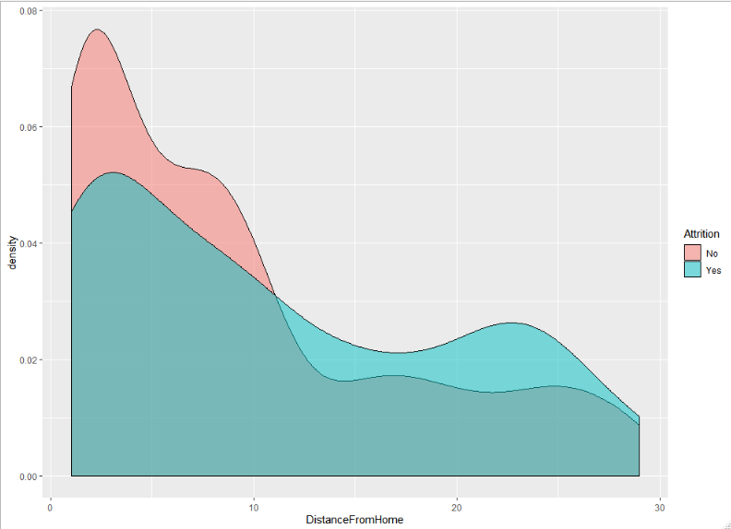
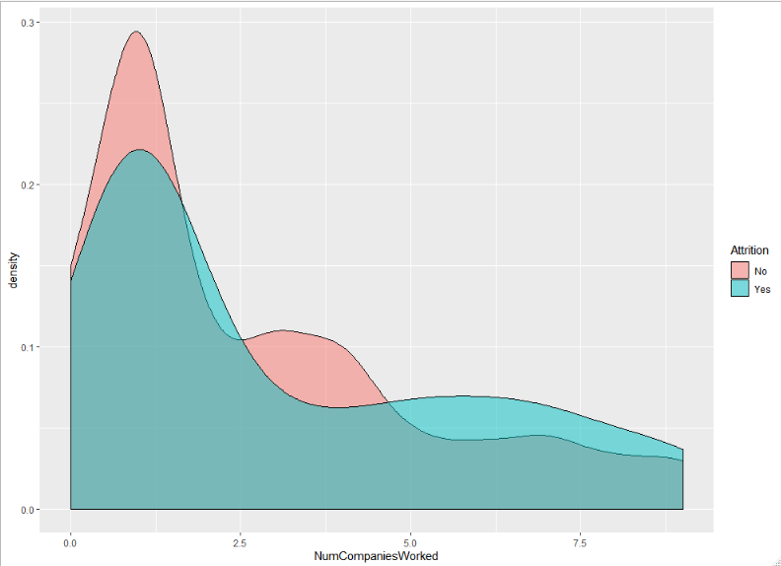
Density plots for: Total working years, Monthly Income, Years at company, age, distance from home and Number of companies worked all show differences in attrition rate and thus could be candidates to be included in the models . Using density charts below, even though Number of companies shows some differences in attrition, it does not appear to be a good predictor since people won’t change their work or get terminated based on how many companies they worked at.
Total Working Years
Monthly Income
Years at company
Age
Distance From Home (Commute)
Number of Companies worked

Slide 8
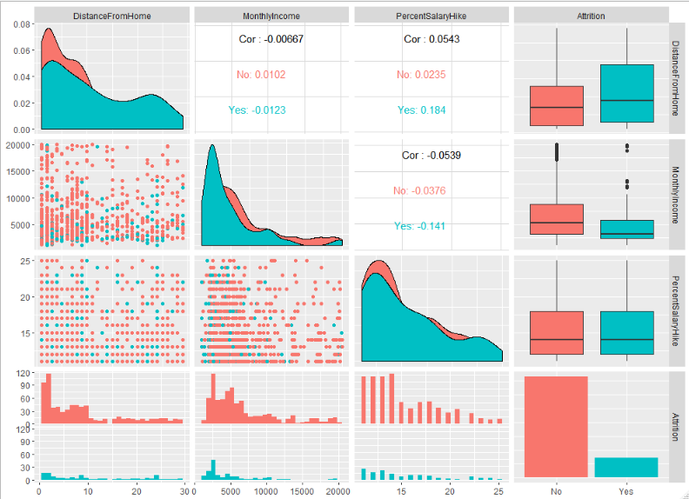
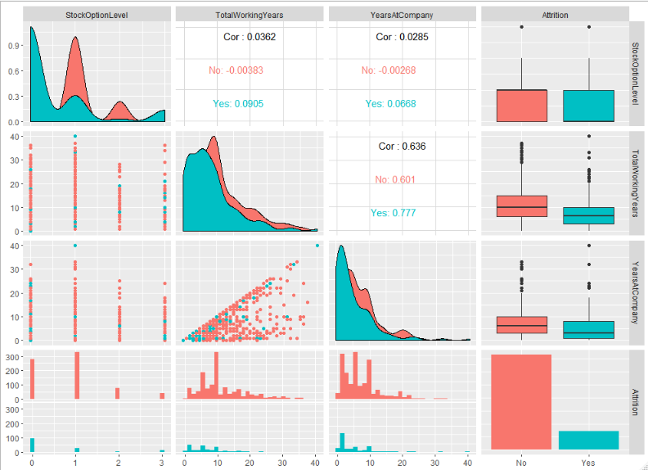
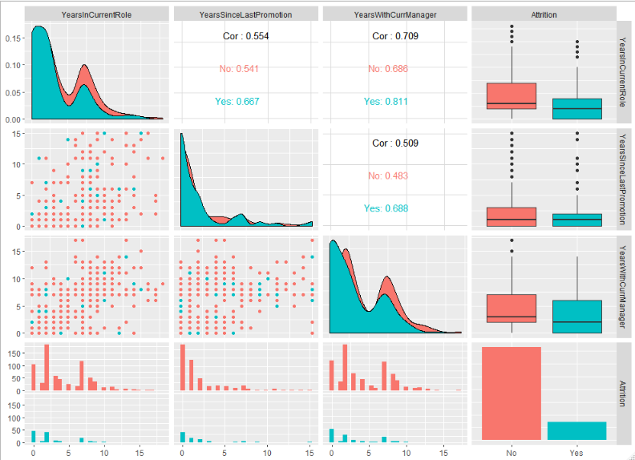
Figure 1 ggpair plot between Attrition, Distance from Home, Monthly Income and Percent Salary Hike. The boxplots in figure 1 indicate that Distance from home and Monthly Income show differences between the means of attrition = Yes and No and thus both will be included in the model. Figure 2 indicates stock option level is a significant contributor to attrition. Also, total working years is an influencer. However, since Total Working Years and Monthly Income have a correlation of 0.78, Monthly income only will be included in the model.
Figure 3 shows that none of these variables: Years With Current Manager, Years At Company and years since last promotion exhibits and influence over attritions and thus will be excluded.
Figure 1
Figure 2
Figure 3

Slide 9
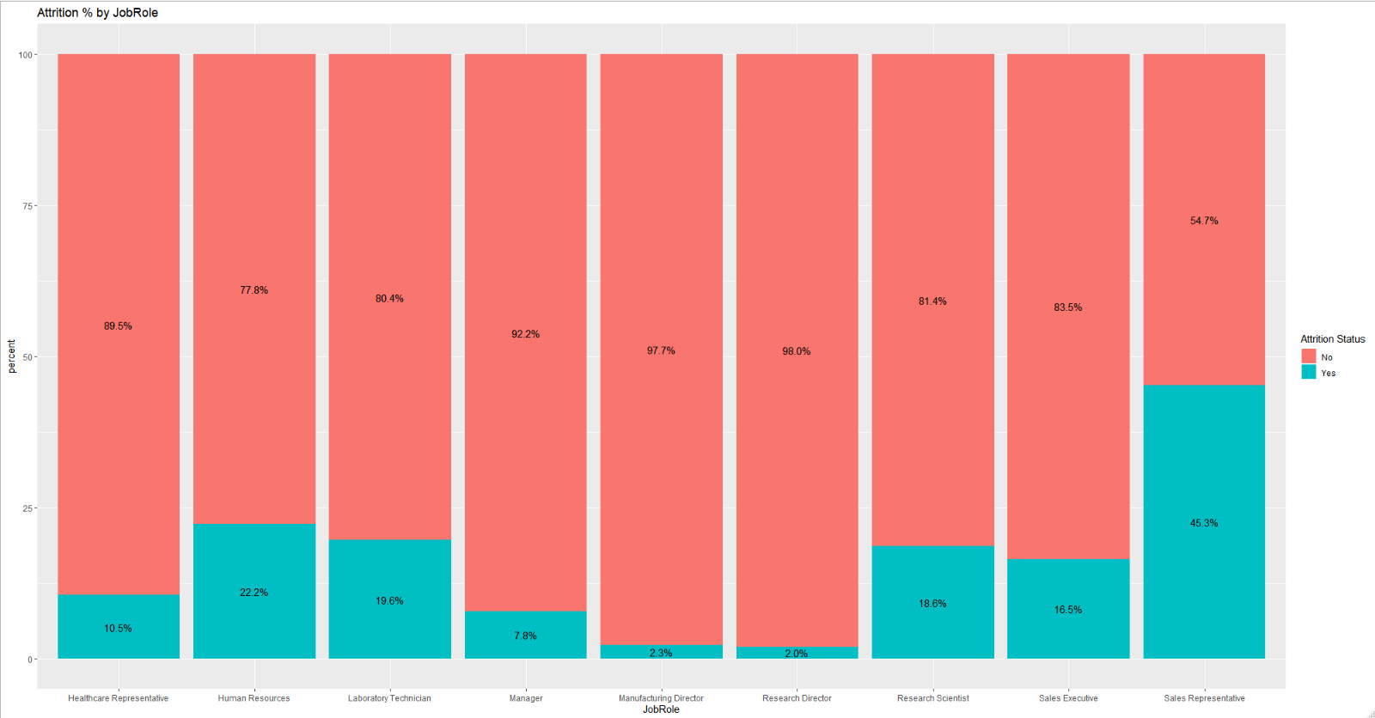
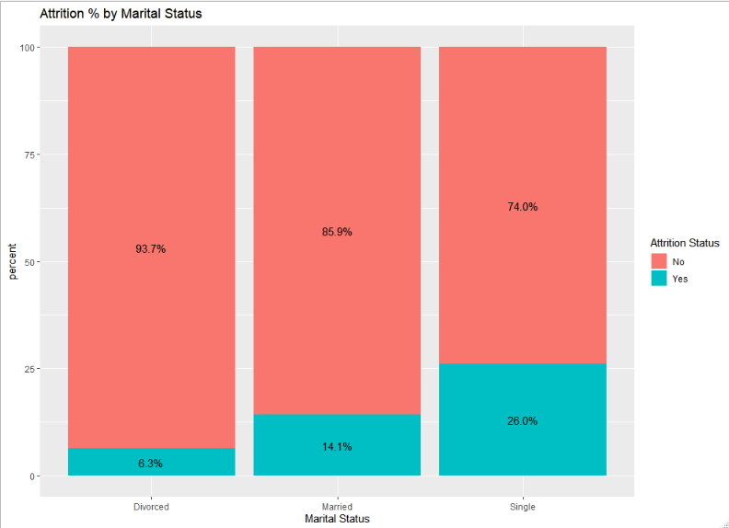
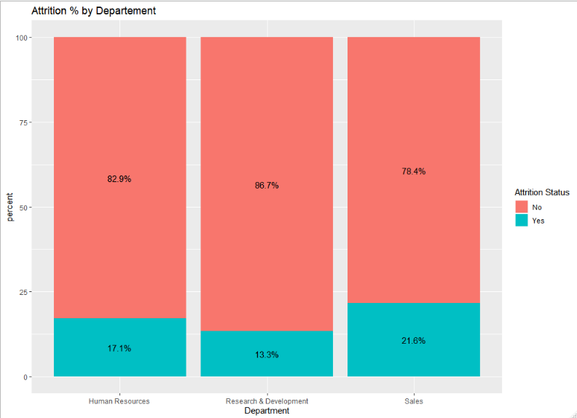
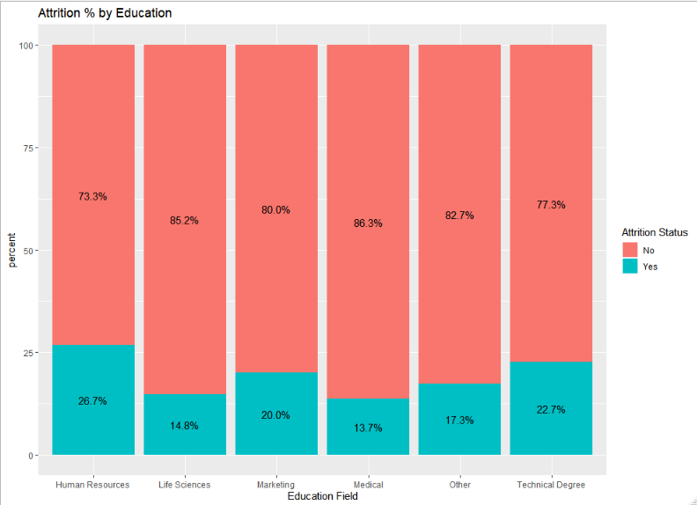
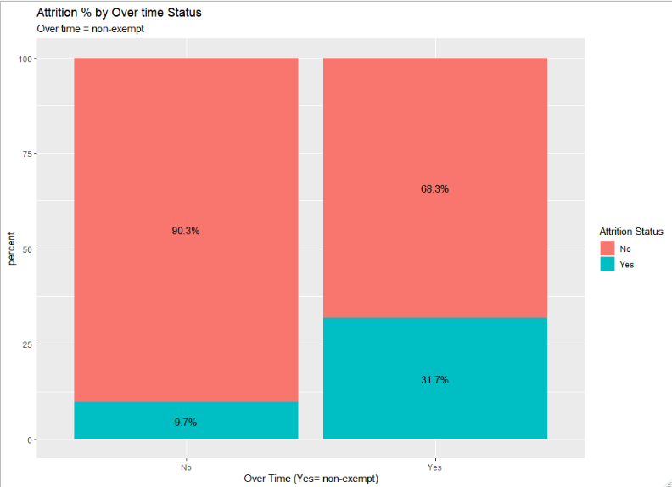
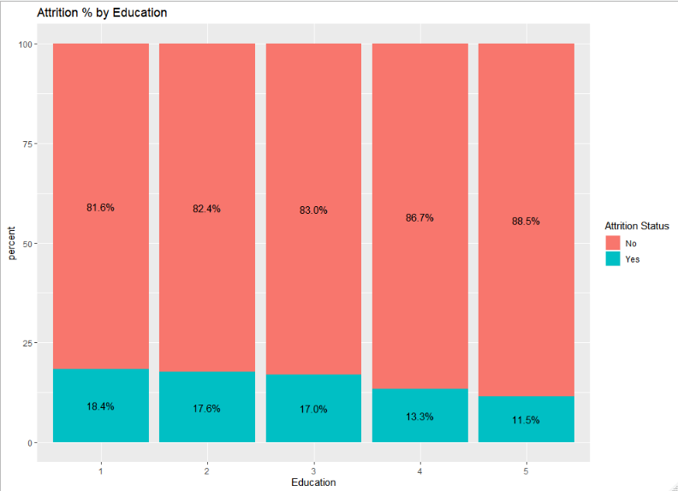
Categorical analysis using column plots reveals multiple variables that have significant influence over the attrition. Figure 1 shows that the attribution rate changes significantly between the Job roles. A note worthy, is that Sales Representatives have an attrition rate that is twice as high (45.3%) as the next category which is 22%. Figure 2, Marital status also shows attrition differences between the categories, singles have the highest attrition rate at 26%. The attrition rate by department seems to be almost equivalent across the departments and does appear to be an influencer of attrition (Figure3). Education field (Figure 4 ) shows some differences but they are not that significant. However, Figures 5 shows that over-time (Non-exempt) employees are 3 times as likely to experience attrition. Finally, and surprisingly, it appears that Education level does not present itself as a contributor to attrition as shown if Figure 6.
Figure 1 Job Role
Figure 2 Marital Status
Figure 3 Department
Figure 4 Education Field
Figure 5 Over Time (Exempt/non-exempt)
Figure 6 Education (level)

Slide 10
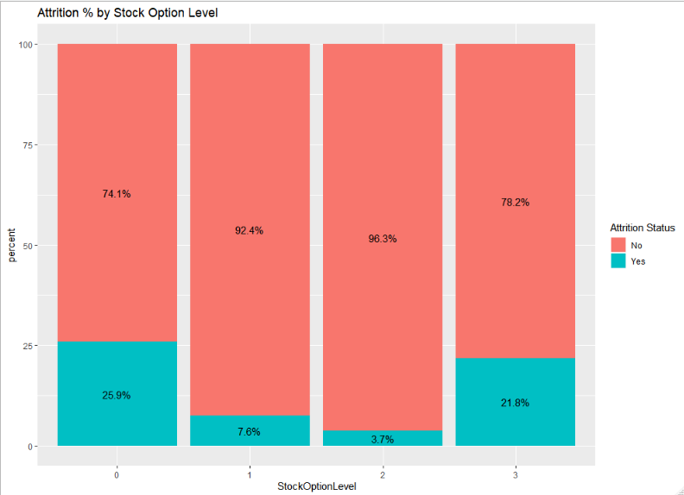
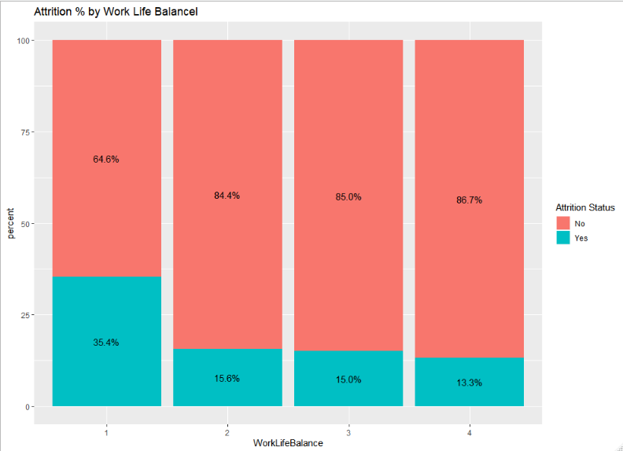
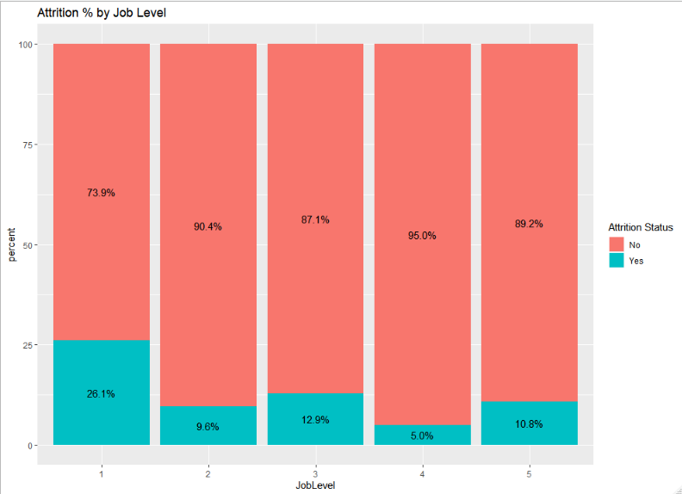
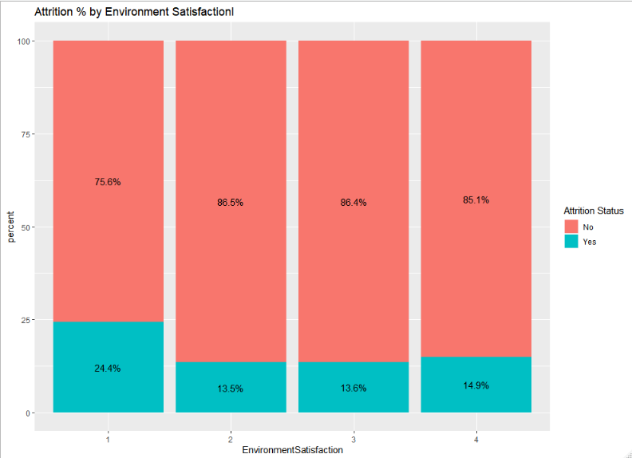
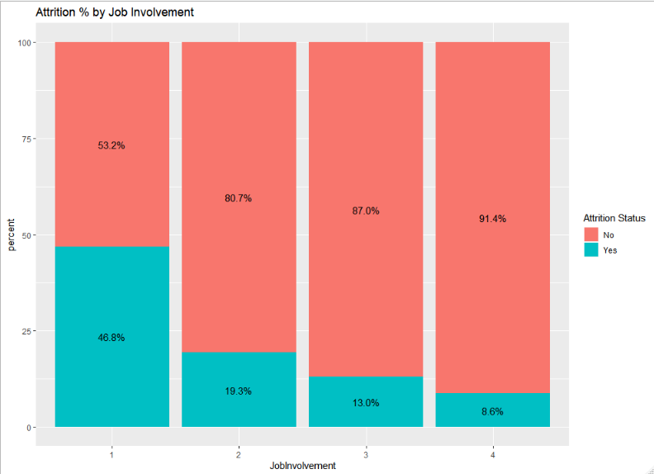
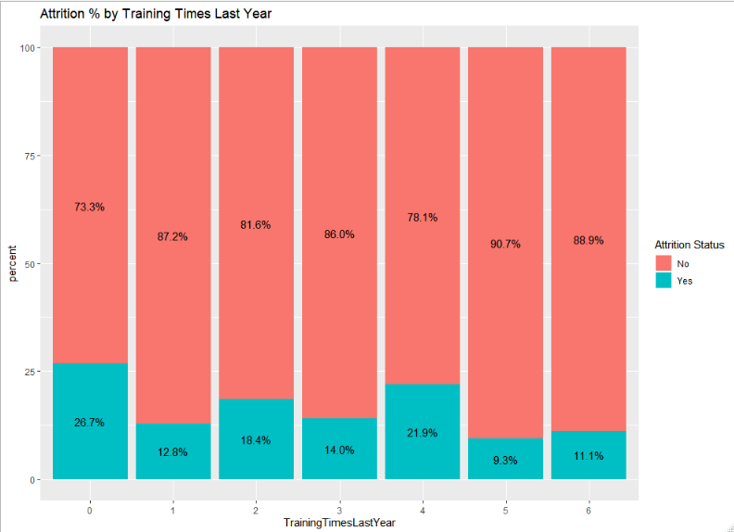
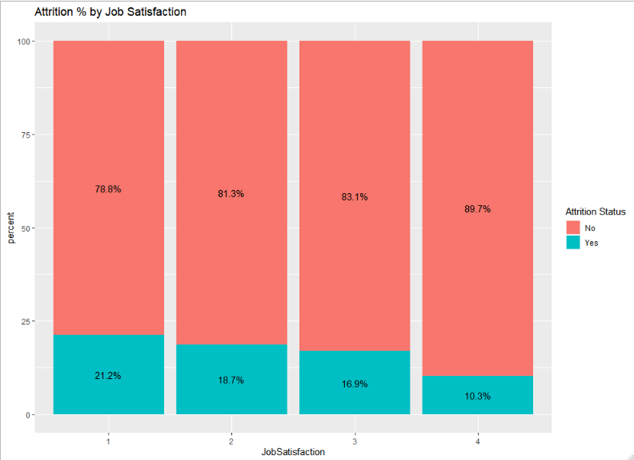
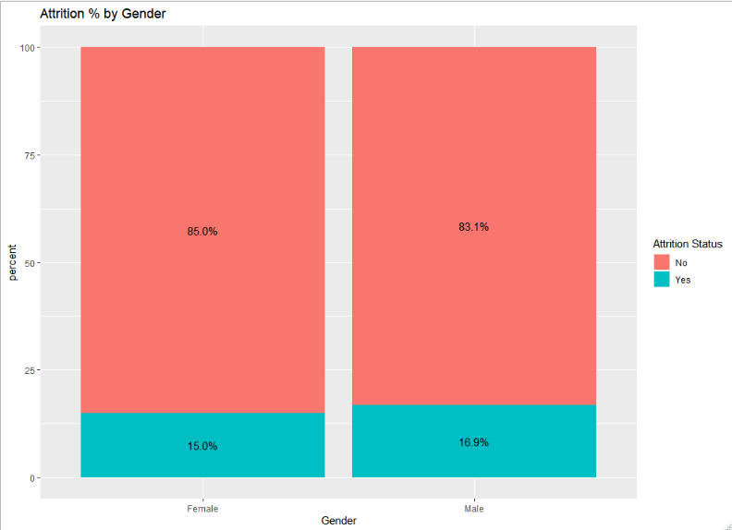
Stock option, Figure 1, shows that the attribution changes significantly based on the levels being offered. The Work Life Balance, Figure 2, shows some minor differences with employees rating the work life balance as lowest have the highest attrition rate at 35% while the rate is consistent across the other categories, almost 16%. Job level, Figure 3, also shows to have significant influence over the attrition. The satisfaction with the work environment, Figure 4, Shows that employees that are most dissatisfied have the highest attrition of 24.4%. Job Involvement, Figure 5, is the most interesting as it highlighting the fact that employee value being involved the most have the least attrition rate. Training time seems to also play a significant role in attrition while Job satisfaction shows less of an influence. On the other hand, Gender has not role at all in attrition base on Figure 8.
Figure 1 Attrition by Stock Option Level
Figure 2 Attrition by Work Life Balance
Figure 3 Attrition by Job Level
Figure 4 Attrition by Environment Satisfaction
Figure 5 Attrition by Job Involvement
Figure 6 Attrition by Training Times
Figure 7 Attrition by Job Satisfaction
Figure 8 Attrition by Gender
Notes:
Figure 1 – the lowest and Highest levels have the most attritions. Lowest could be leaving do to dis-satisfaction and highest could be leaving because they are being recruited externally.

Slide 11
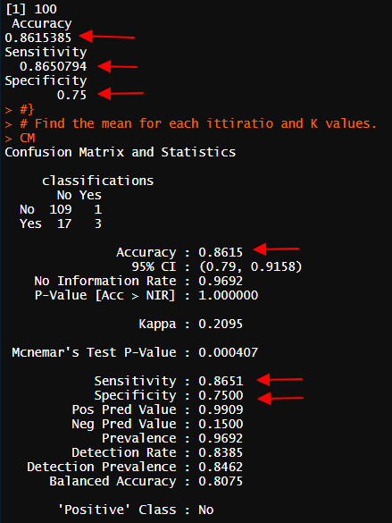
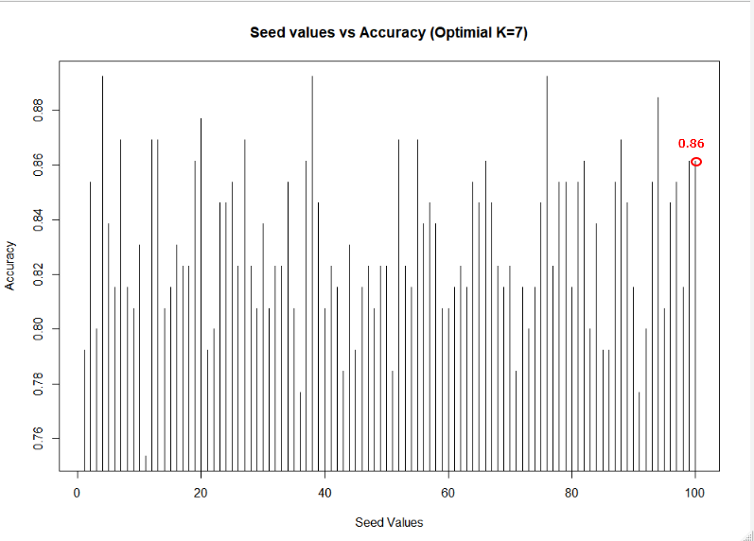
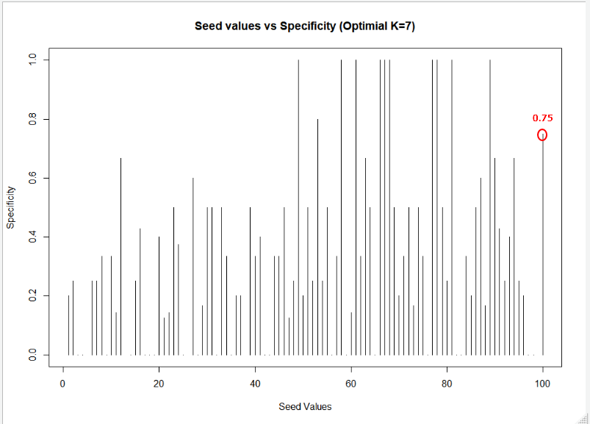
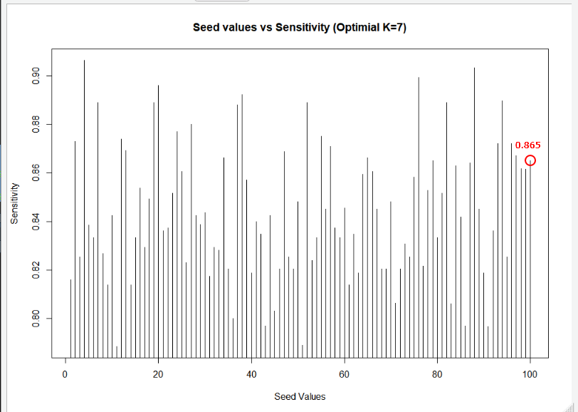
KNN Model
Using the analysis of the categorical and continuous variables conducted above, the following variables were selected to fit a KNN Model: StockOptionLevel, DistanceFromHome, MonthlyIncome, JobInvolvement. Through multiple iteration of K, Seed optimization, and different train/test split ratios the following parameters were the most optimal:
K= 7, Split = 85%, and Seed = 100.
With these parameters, the model was fitted and trained and the below are the outcomes: prediction Accuracy = 86.1%, Specificity = 75% Sensitivity = 86.5%
Figure 1: KNN Model - Accuracy
Figure 2: KNN Model - Specificity
Figure 3: KNN Model - Sensitivity
Notes:
Specificity is a measure of the proportion of negatives that are truly negative. Sensitivity is a measure of the proportion of positives that are correctly identify positive observations. In evaluation of a prediction model, they can be used to reflect the performance of the model. Imaging a perfectly fitted model that can predict outcomes with 100% accuracy, both sensitivity and specificity are 100%.

Slide 12
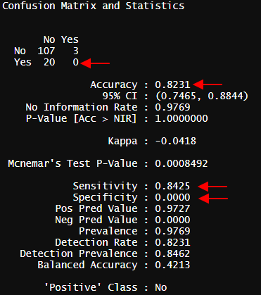
Naïve-Bayes Model
The Naïve-Bayes model produced similar results as the KNN model but the accuracy was lower, 82% versus 86% and the sensitivity what at 84%. However the specificity came out to be 0. As a result, I decided to use the KNN model since it produce a better results with regards to the specificity.

Slide 13
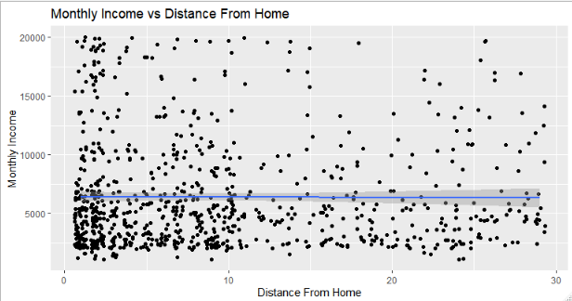
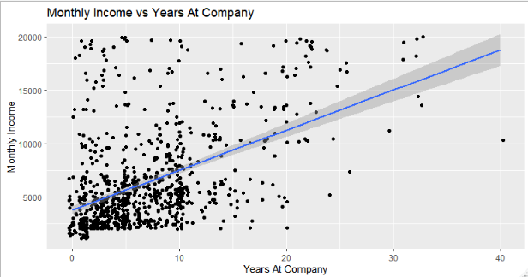
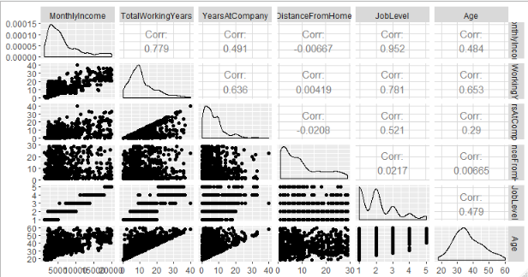
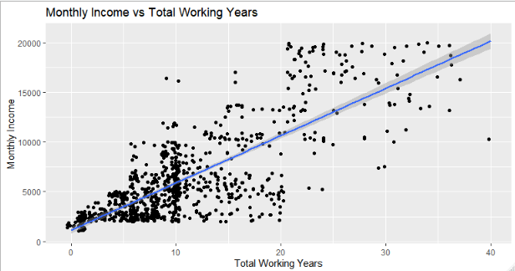
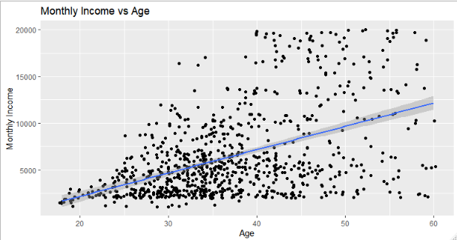
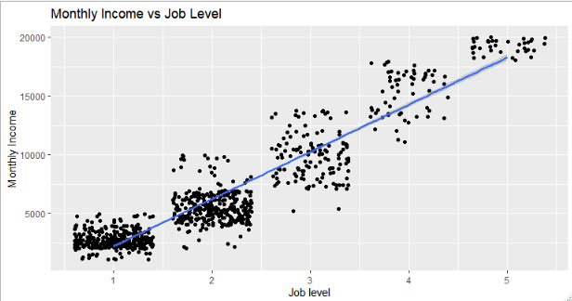
Linear Regression Model
The GGPLOT and point plots confirm the assumptions. There is no evidence against normal distributions. With the exception of Distance from home, there does not seem to be much evidence against a linear relationship between the means and there does not seem to be much evidence of non-constant standard deviation of the normal distributions.

Slide 14
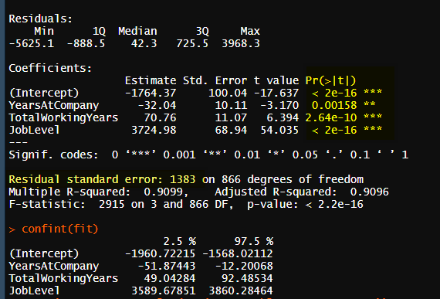
Linear Regression Model
Based the analysis above, the following variables will be user to fit the model: Monthly Income, Years At Company, Total Working Years, Job Level. This model very low P value of less than 2.2⁻¹⁶ and a Root Mean Square error of $1383 with a 95% confidence interval.

